Slide 1
Digital Frameworks
Lesson 4
Medill on the Hill
Rachel Shorey
https://github.com/rshorey/digitalframeworks-spring18

Slide 2
Data stories
https://www.nytimes.com/interactive/2018/04/24/upshot/women-and-men-named-john.html

Slide 3
Data Formats
Like eating your vegetables, but with commas

Slide 4
When you ask someone for data...
They will probably give it to you in whatever format is easiest for them.
That might not be the format that is easiest for you.
Notes:
So we’re going to talk it through.

Slide 5
Spreadsheets
Sometimes you get a spreadsheet.

Slide 6
Spreadsheets
Sometimes you get a spreadsheet.
This is great

Slide 7
Spreadsheets
Sometimes you get a spreadsheet.
This is great
Unless you don’t have MicrosoftOffice2001 or whatever they used to create it.
Notes:
State governments, man.

Slide 8
CSVs: So much like spreadsheets
CSV stands for “comma separated values”
They are a bunch of values. With headers. Separated by commas.
...if you’re lucky.

Slide 9
CSVs: So much like spreadsheets
Looks easy enough:
name,state,profession,favorite color
Alice,AL,Artist,Aqua
Carl,CA,Cartographer,Cyan
Darlene,DE,Doctor,Dark Green
Frank,FL,Firefighter,Fuchsia

Slide 10
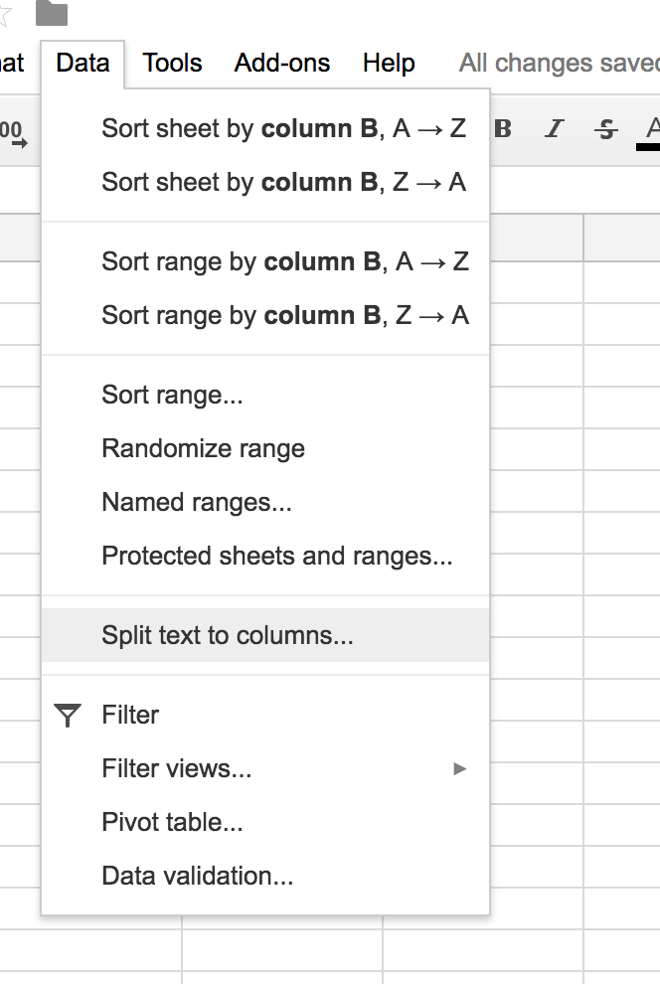
CSVs: So much like spreadsheets
Even easy to convert to a spreadsheet
Notes:
This is in google sheets, excel has a similar option

Slide 11
CSVs: So much like spreadsheets
Things to watch out for: the extra comma
name,state,profession,favorite color
Alice,AL,Artist,Aqua
Carl,CA,Cartographer,Cyan
Darlene,DE,Doctor,Dark Blue
Frank,FL,Firefighter,Fuchsia
Greg,GA,Geophysics, Professor Of,Green
Notes:
What if Greg inputs his profession in an odd way? Now we’ve got an extra comma, and all our lines are messed up

Slide 12
CSVs: So much like spreadsheets
Things to watch out for: the extra comma
name,state,profession,favorite color
Alice,AL,Artist,Aqua
Carl,CA,Cartographer,Cyan
Darlene,DE,Doctor,Dark Blue
Frank,FL,Firefighter,Fuchsia
Greg,GA,"Geophysics, Professor Of",Green
Notes:
There are several ways to deal with it. The most common is to put the offending entries in quotes.
But Rachel, you ask, what if the offending line also has quotes?

Slide 13
CSVs: So much like spreadsheets
Things to watch out for: the rogue quote
name,state,profession,favorite color
Alice,AL,Artist,Aqua
Carl,CA,Cartographer,Cyan
Darlene,DE,Doctor,Dark Blue
Frank,FL,Firefighter,Fuchsia
Greg,GA,"Geophysics, "World’s best" Professor Of",Green
Notes:
But Rachel, you ask, what if the offending line also has quotes?

Slide 14
CSVs: So much like spreadsheets
Things to watch out for: the rogue quote
name,state,profession,favorite color
Alice,AL,Artist,Aqua
Carl,CA,Cartographer,Cyan
Darlene,DE,Doctor,Dark Blue
Frank,FL,Firefighter,Fuchsia
Greg,GA,"Geophysics, \"World’s best\" Professor Of",Green
Notes:
The slash is known as an “escape character” and means “the next thing is actually the thing I typed, not a formatting signifier”

Slide 15
CSVs: So much like spreadsheets
Escape Characters
If you’re using a formatting convention, the escape character (usually a “\”) says “the thing that’s coming next is text, not formatting.

Slide 16
CSVs: So much like spreadsheets
Escape Characters
So in a CSV
\" is an actual quote mark
And \\ is an actual backslash
Notes:
This is useful beyond CSVs, it comes up in other data formats and programming languages.

Slide 17
CSVs: So much like spreadsheets
Your spreadsheet program just deals with this
If you open a file with the .csv extension in excel or google docs, it usually just deals with the formatting itself.
If you save an excel or google docs file as a csv, it puts in the right formatting

Slide 18
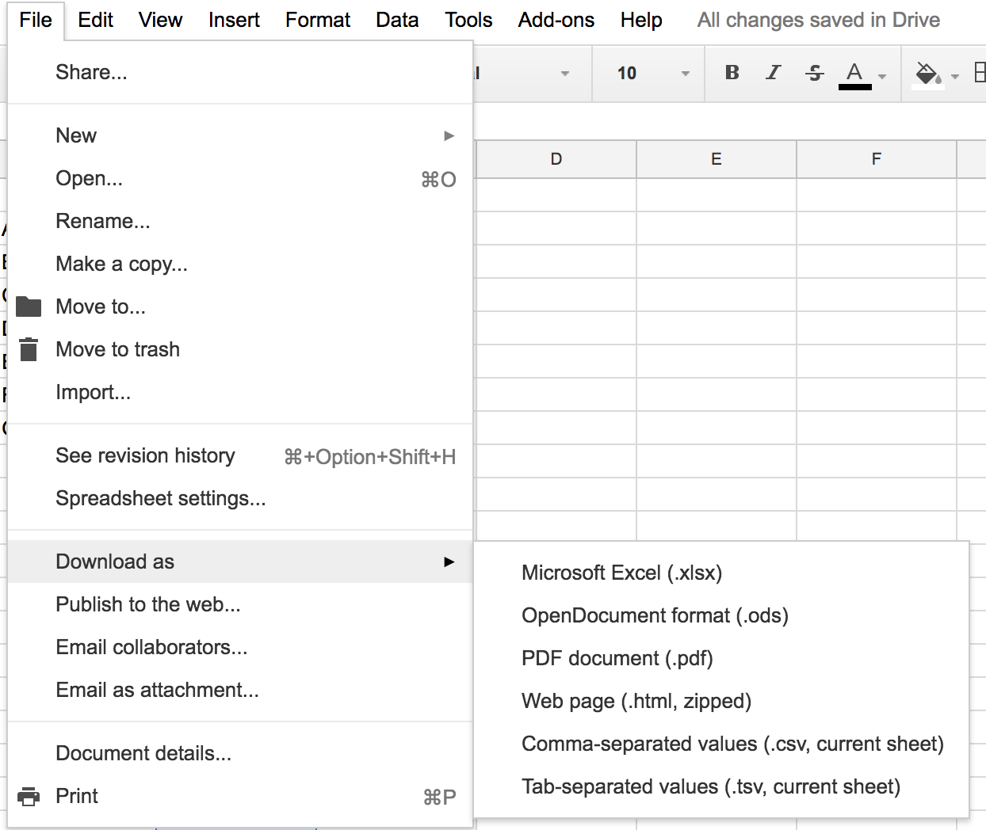
CSVs: So much like spreadsheets
Saving a spreadsheet as a CSV
Notes:
this is google docs again, we will talk about some of these other formats later.

Slide 19
CSVs: So much like spreadsheets
If Excel takes care of it, why does it matter what’s happening under the hood?
Notes:
Because when excel chokes on your file, it’s helpful to be able to look at it and figure out why.

Slide 20
CSVs: So much like spreadsheets
Things to watch out for: the truncated zero
name,state,profession,favorite color,zipcode
Alice,AL,Artist,Aqua,35006
Carl,CA,Cartographer,Cyan,90210
Darlene,DE,Doctor,Dark Blue,19707
Frank,FL,Firefighter,Fuchsia,33134
Greg,GA,Geophysicist,Green,30004
Mary,MA,Mechanic,Mauve,02476

Slide 21
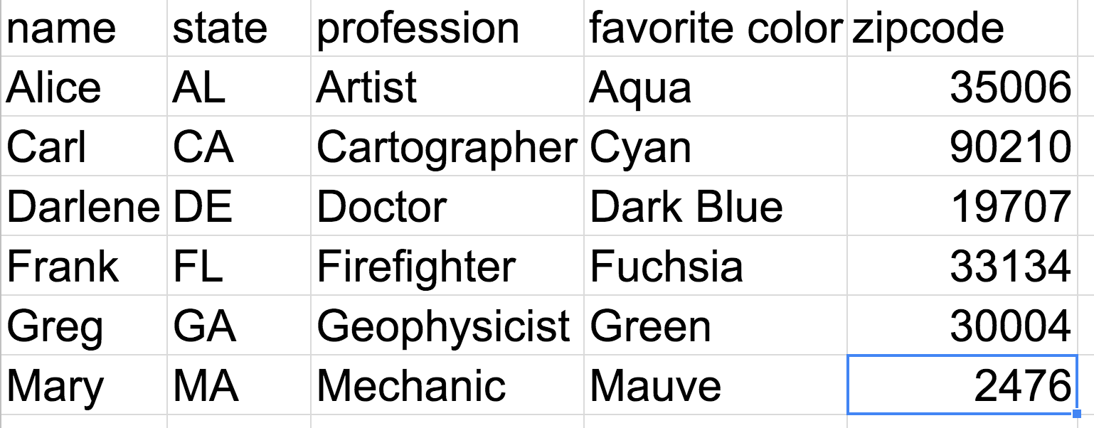
CSVs: So much like spreadsheets
Things to watch out for: the truncated zero

Slide 22
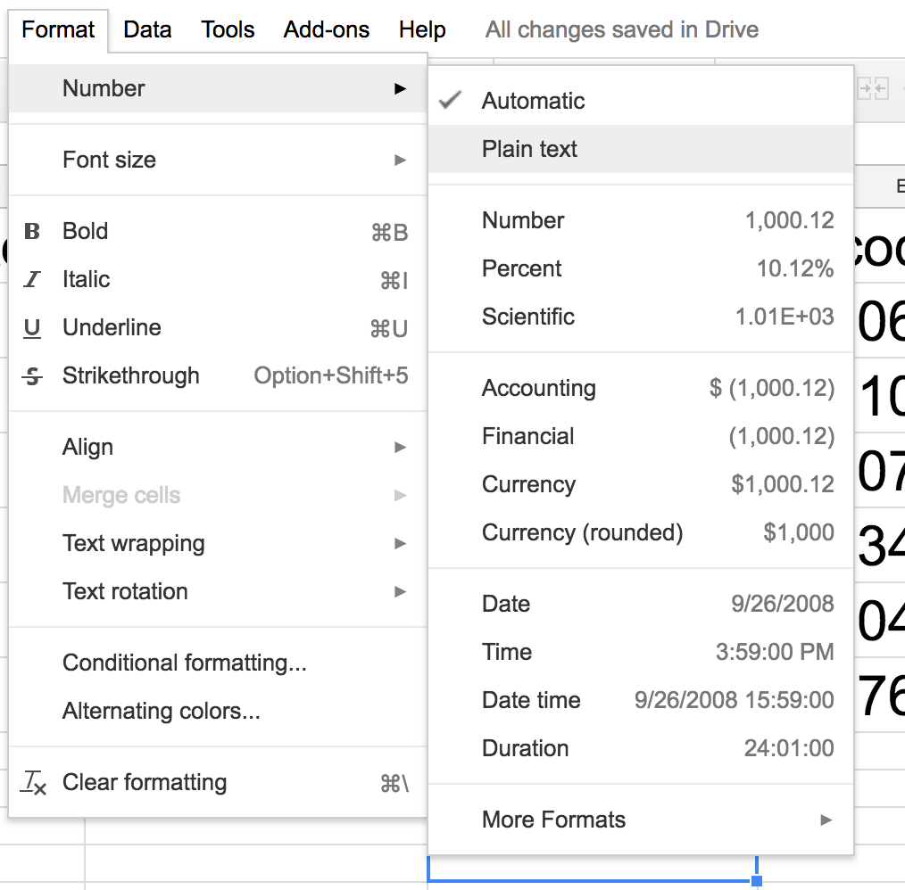
CSVs: So much like spreadsheets
Things to watch out for: the truncated zero
Notes:
Formatting can help

Slide 23
CSVs: So much like spreadsheets
Things to watch out for: the inconsistent line length
I don’t even know how to do this visually, but let me talk about the Federal Elections Commission for a moment
Notes:
The file is called a CSV, but there is no real header, and all lines are different lengths. You can figure out which field they are referring to by looking at the first field of a row, and then checking a lookup table somewhere to see what the headers are supposed to be. In short, it is not a CSV. It is a file, with commas, that they call a CSV because what else would they call it?

Slide 24
CSVs: So much like spreadsheets
Things to watch out for: when we said comma, we meant…
One way that people deal with commas in fields (apart from quoting, which we discussed) is to pick a different character to separate the fields.

Slide 25
CSVs: So much like spreadsheets
Things to watch out for: when we said comma, we meant…
These separators are called delimiters. Here are some I’ve seen:
| , (tab) $ # ; : but really it could be anything
Notes:
Spreadsheet programs know how to handle these, but you often need to know what it is in order to tell excel or google docs.

Slide 26
CSVs: So much like spreadsheets
Things to watch out for: line break characters
When we hit “enter” or “return”, we know what it looks like on our screen, but there are many ways a computer can represent that internally.

Slide 27
CSVs: So much like spreadsheets
Things to watch out for: line break characters
Usually your spreadsheet program can deal with these, but sometimes it’ll insert extra lines.
It can help to look at the raw text version of your CSV (we will discuss this later)

Slide 28
Fixed Width Files
Sometimes someone will deal with the many potential CSV pitfalls by giving you a “Fixed Width File”
These are the work of the devil.

Slide 29
Fixed Width Files
These look something like this
Alice ALArtist Aqua
Carl CACartographer Cyan
Darlene DEDoctor Dark Green
Frank FLFirefighter Fuchsia

Slide 30
Fixed Width Files
...and come with a dictionary that looks something like this
Column Width Description
1 10 Name
2 2 State
3 15 Profession
4 10 Favorite Color

Slide 31
Fixed Width Files
There are always errors:
The creator specified their widths before they saw all their data, so there is some field that doesn’t fit and had to be truncated.
Alice ALArtist Aqua
Carl CACartographer Cyan
Darlene DEDoctor Dark Green
Frank FLFirefighter Fuchsia
Mary CatheMAMotorcycle RepaMidnight B
Notes:
Poor Mary Catherine the Motorcycle Repairwoman who loves Midnight Blue!

Slide 32
Fixed Width Files
There are always errors:
Someone tries to fix the formatting issue and ends up messing up the spacing of the whole file

Slide 33
Fixed Width Files
There are always errors:
The key is not maintained and it is full of lies.

Slide 34
Fixed Width Files
There are always errors:
If anyone offers to pull some data for you and asks you what format you’d like, tell them anything, ANYTHING but fixed width.
You have been warned.

Slide 35
CSVs (and their friends) have schemas
What is a schema?
It tells you what fields your data will have and (sometimes) what to expect from that data
In the case of a CSV, that’s the column name

Slide 36
Schemas: Pros and Cons
Schemas are great if you want very consistent data. You will get the same fields in each row, which is very helpful for sorting, summing, averaging...

Slide 37
Schemas: Pros and Cons
...but it’s not always how the world works.
Notes:
What if you collect data from multiple sources, and they have some different fields?
What if some of your data has a characteristic and some does not?
What if there are some categories that can have multiple values?

Slide 38
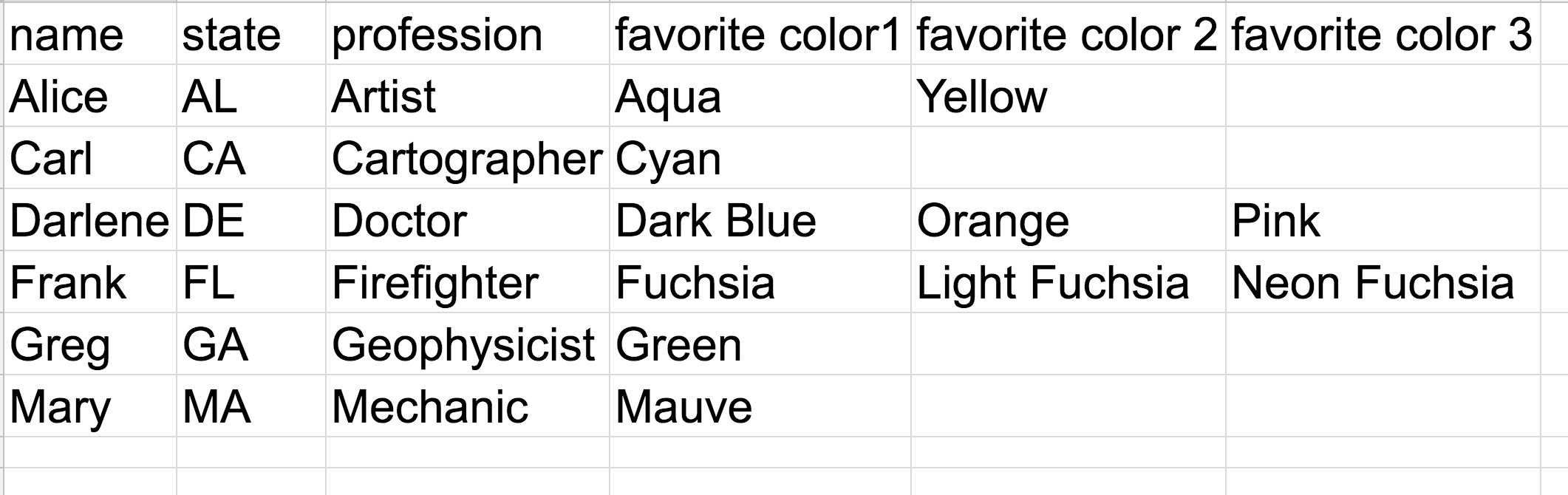
CSVs: the multiple category problem
Notes:
We see this problem a lot with things like tags...you can have as many as you want, where do we put them? In this case, what if someone keeps on listing colors? How many columns should we add? What if they list even more colors?

Slide 39
Going Schema-less
Allows you to structure your data more like the way the world is structured
But...if you don’t know what’s going to be in there, how are you going to find it?
Notes:
Data storage systems that do not require a pre-defined set of keys are often called schemaless. We’ll critique this in a bit later.

Slide 40
Two data formats:
XML: eXtensible Markup Language (pronounced “X-M-L”)
JSON: JavaScript Object Notation (I’ve heard it pronounced like the name Jason and also “J-sun”, probably with the latter being slightly more common)
Notes:
Despite the programmy names, you don’t actually have to know any javascript or code to make use of XML or JSON

Slide 41
XML: How it works
Tags use <>
Tags are closed with /
Looks very similar to HTML

Slide 42
XML: example
<quiz>
<question1>
<question>How many stripes on the US flag?</question>
<type>Free response</type>
<answer>13</answer>
</question1>
<question2>
<question>How many stars on the US flag?</question>
<type>Multiple Choice</type>
<choices>
<choice1>38</choice1>
<choice2>50</choice2>
<choice3>73</choice3>
</choices>
<answer>50</answer>
</question2>
</quiz>
Notes:
We can easily have different question types and things like an arbitrary number of choices without having to add tons of columns

Slide 43
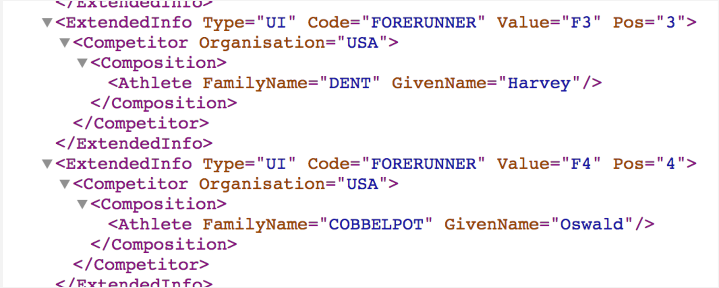
XML: in the wild!
Notes:
The Olympics is one of the most data-heavy things we cover at the NYT. The IOC starts the prep years in advance, we start about half a year ahead. One of my colleagues is currently in South Korea doing data prep. They do extensive testing and feedback with the IOC. Obviously they don’t have actual data yet, so they use fun examples. This is a sample he found amusing that he sent around to the team (from Korea) this morning. This is how we will keep track of olympic data during the events.

Slide 44
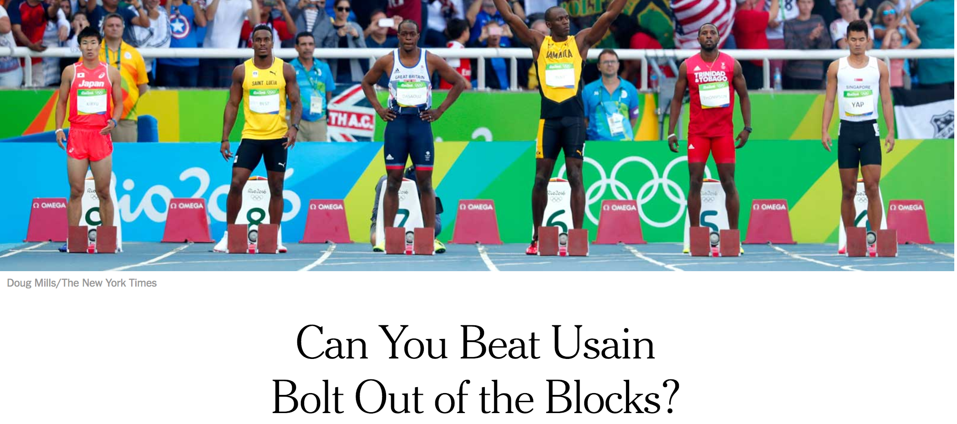
Powered by Olympic XML

Slide 45
Powered by Olympic XML
https://www.nytimes.com/interactive/2016/08/20/sports/olympics/gold-medal-racing-speeds-on-the-same-scale.html (impossible to screenshot this one!)

Slide 46
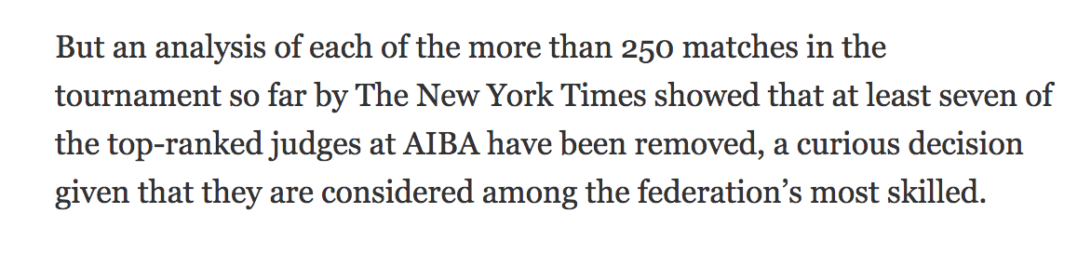
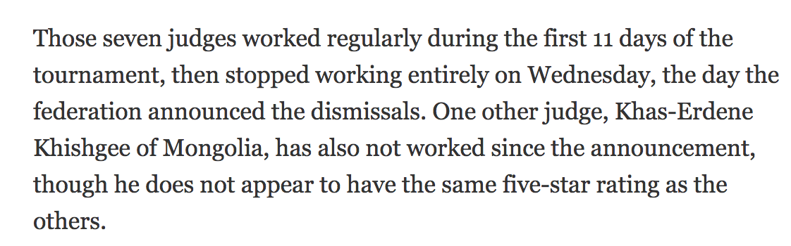
Powered by Olympic XML
Notes:
The olympic XML is incredibly detailed, and includes things down to judges. My colleagues found some interesting stuff by looking at that. Fun fact: Scott Blumenthal, the data analyst behind this story, is also a competitive fighter himself (he showed up to work the other day with a busted up eyebrow) so I would not be surprised if we hadn’t found this story if we hadn’t had a data/boxing person on our staff. https://www.nytimes.com/2016/08/21/sports/olympics/boxing-judges-dismissal-robed-in-secrecy.html

Slide 47
JSON: How it works
The symbols [ ] let you make a list of an arbitrary number of values (this is a list)
The symbols { } let you make a lookup table with a fieldname (called a “key”) and a value (this is an object)
The symbol : separates keys from values
Strings of characters are in quotes
You can nest lists and objects infinitely
Notes:
This syntax creates a thing called an object in javascript. It takes a lot of getting used to, but is incredibly useful and flexible and is quickly becoming

Slide 48
JSON: example
[
{
"question" : "How many stripes on the US flag?",
"type" : "Free response",
"answer" : 13
},
{
"question" : "How many stars on the US flag?",
"type" : "Multiple Choice",
"choices" : [38, 50, 73],
"answer" : 50
}
]
Notes:
Spacing doesn’t matter at all, outside of quote marks it’s excluded

Slide 49
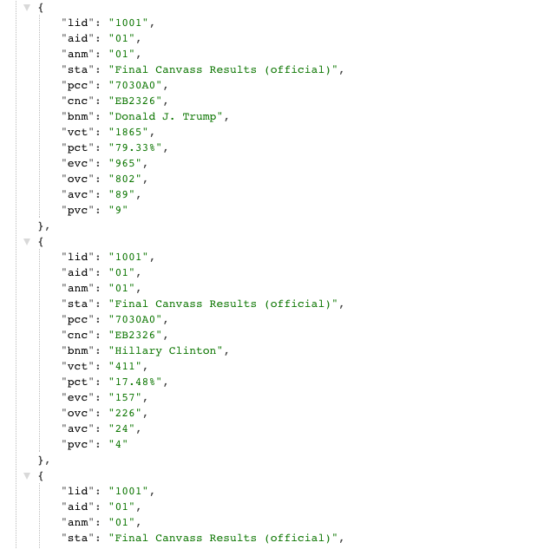
JSON in the wild
Notes:
This is the back end of NC’s 2016 election results, it was published here live as it went on their website we pulled updates from each county every 10 minutes.

Slide 50
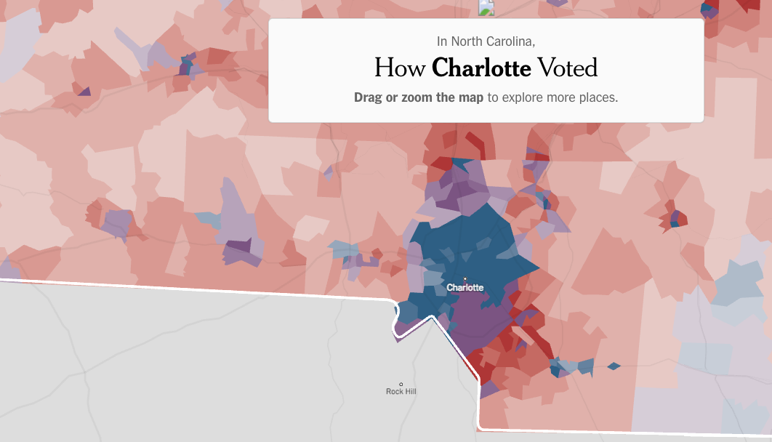
Powered by NC’s election JSON
Notes:
In fact, the associated press’ data all comes as JSON, so basically everything you saw about the 2016 election was powered by JSON.

Slide 51
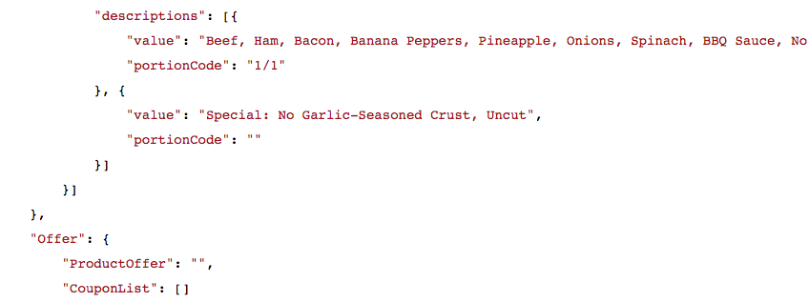
The backend of Domino’s website
Notes:
Why is this important for reporting? Well, probably not in the case of pizza ordering.
Although...imagine the situation where someone makes a very specific claim about pizza that we can disprove by checking out the backend options of dominos website - “I didn’t murder him, he was allergic to the eggplant on the pizza we ordered”...

Slide 52
Going Schema-less
Let’s think about schemas again.
Notes:
Is anything really schemaless? If we used different keys in each entry, different list/value formats, how would we ever find anything? JSON/XML are useful for when you might need to add an extra value or everything is slightly different, and very useful in the multiple category scenario, but if you really throw the kitchen sink in there, it doesn’t work.

Slide 53
But CSVs (and spreadsheets) are just easier
Yup. Thankfully, there are lots of converters out there.
eg:
https://konklone.io/json/
Notes:
Thank you Eric Mill!

Slide 54
SPREADSHEETS! Finally!
And also the Titanic

Slide 55
Titanic dataset
Download the Titanic dataset from the class github repo (here: https://github.com/rshorey/digitalframeworks-spring18/blob/master/titanic.csv)
(note: data borrowed from here: http://web.stanford.edu/class/archive/cs/cs109/cs109.1166/problem12.html)

Slide 56
Things to try
Import data
Check data
Freeze top row
Sort data

Slide 57
Things to try
Who paid the most?
Who was the youngest person?
Who was the youngest person to survive?

Slide 58
Simple functions
Number of passengers
Total amount paid
Average age
Maximum sibs/spouses
Number that survived
Number that did not survive
Percent that survived

Slide 59
Per person functions
How many relatives did each person have?

Slide 60
Pivot Tables
What is the average fare paid by men and women?
How many people survived in each class?
How many women survived in each class?

Slide 61
Conditional aggregates
How old was the youngest woman in 2nd class who survived?
Notes:
This is stuff you could probably do with pivot tables. But I like conditional aggregates better.

